Slide 1



Slide 2
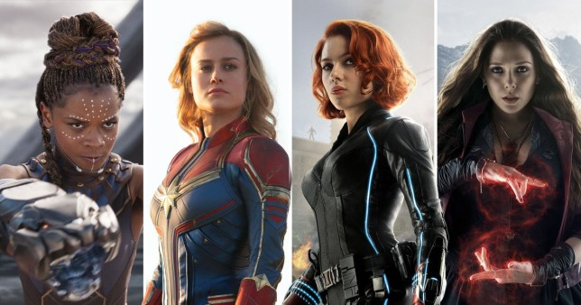
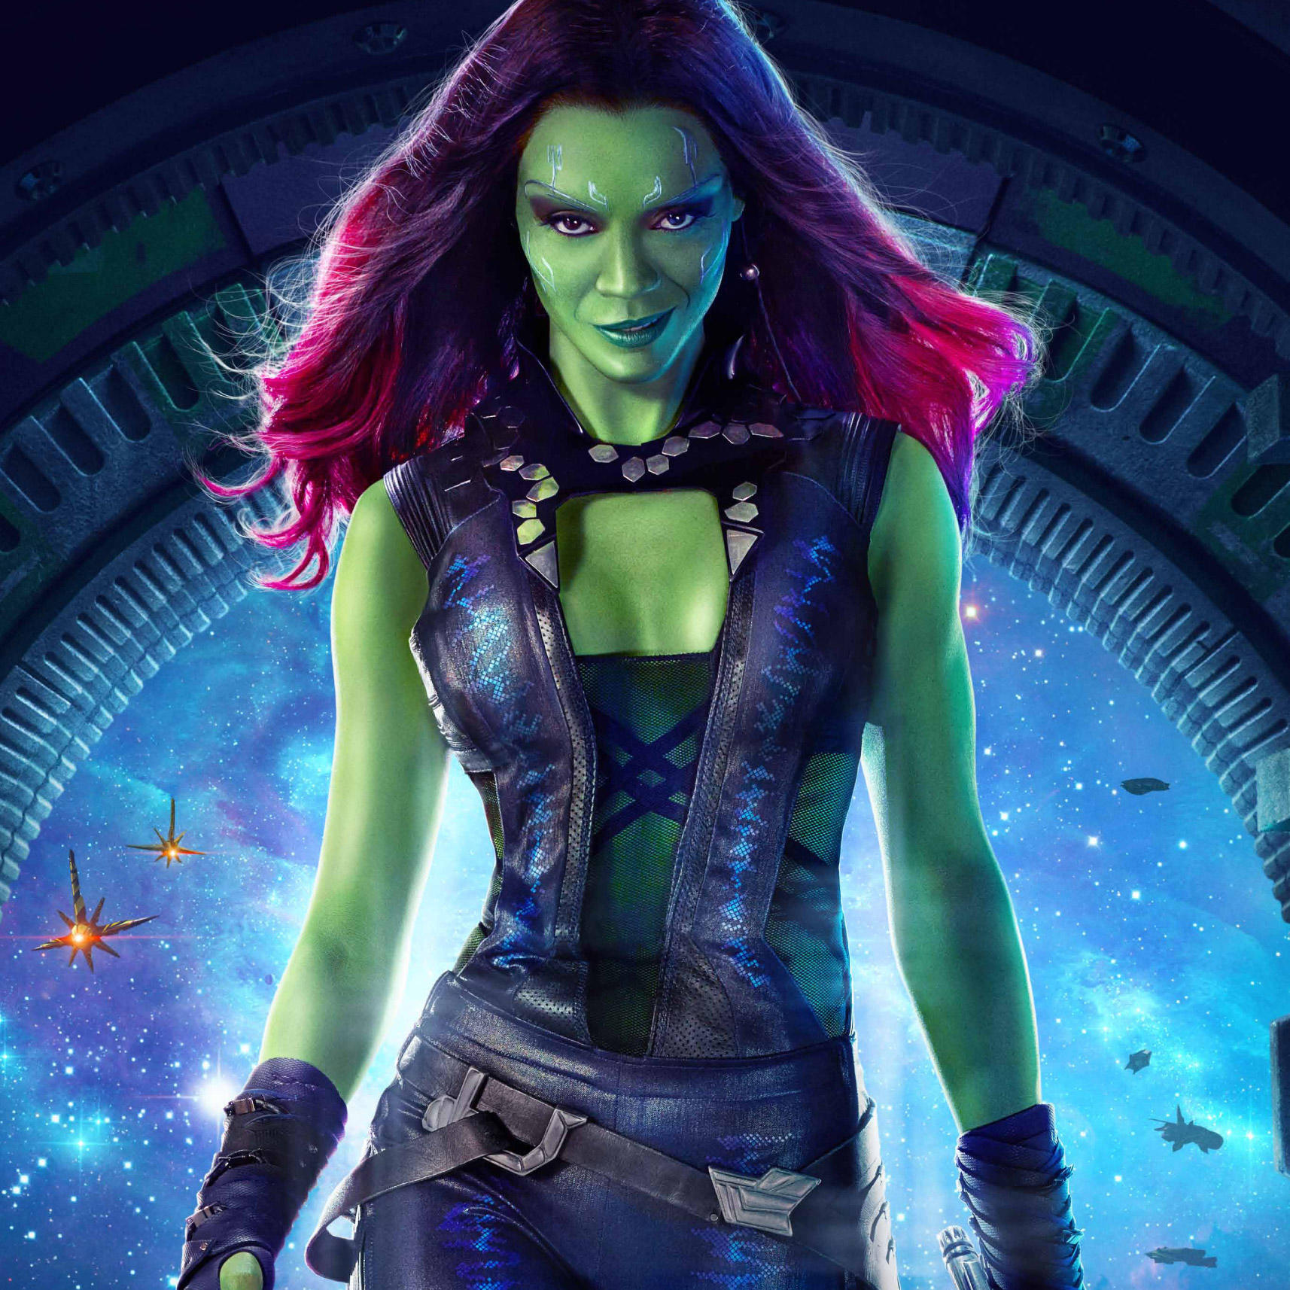

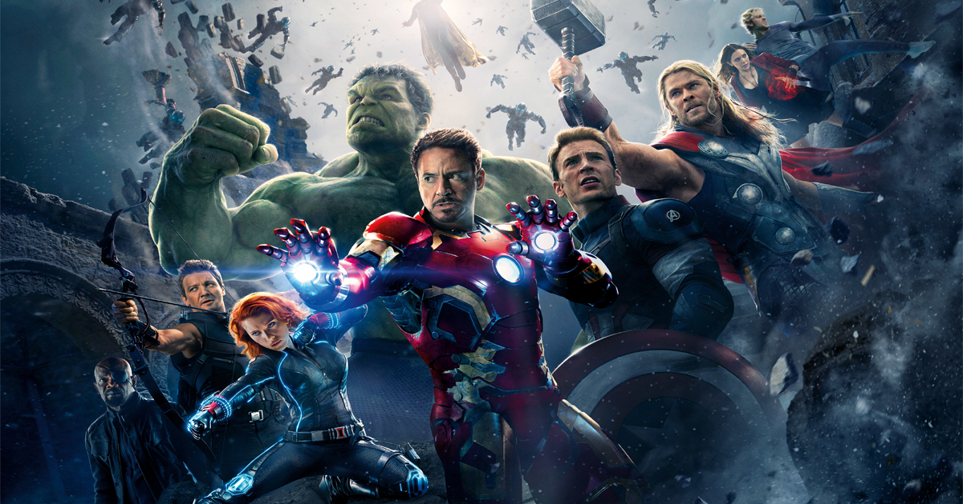
2 minutes – who else could be a hero?
Who are the heroes?
This lot perhaps?

Slide 3
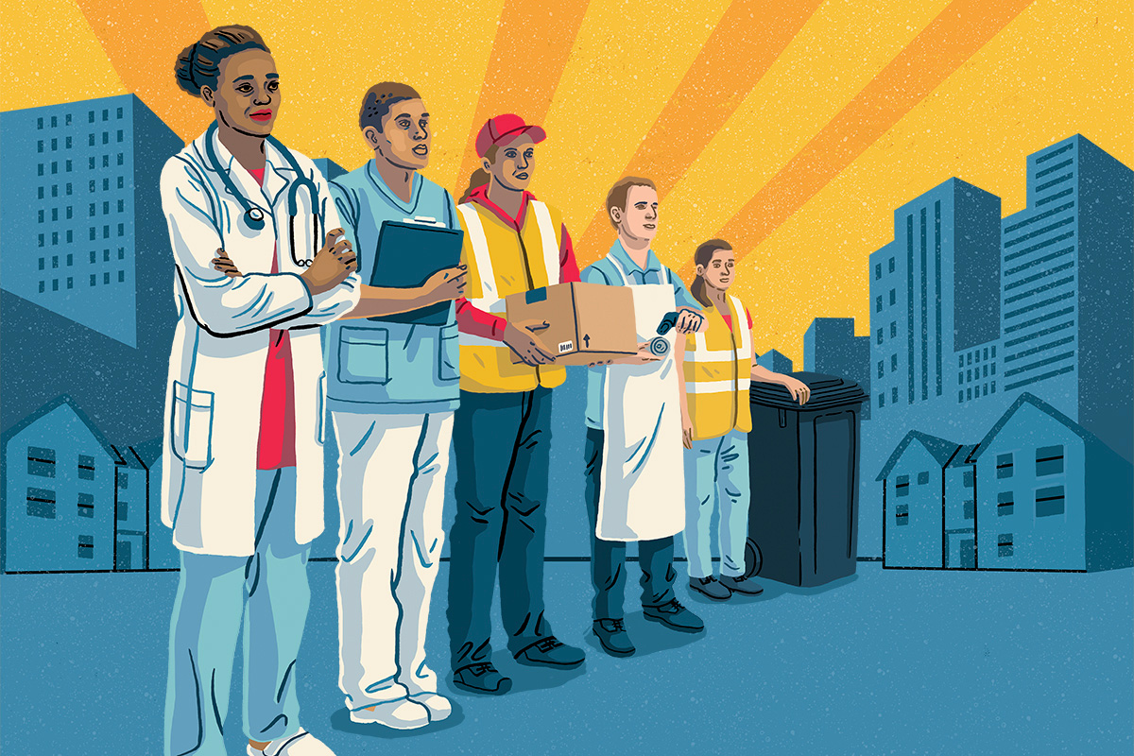
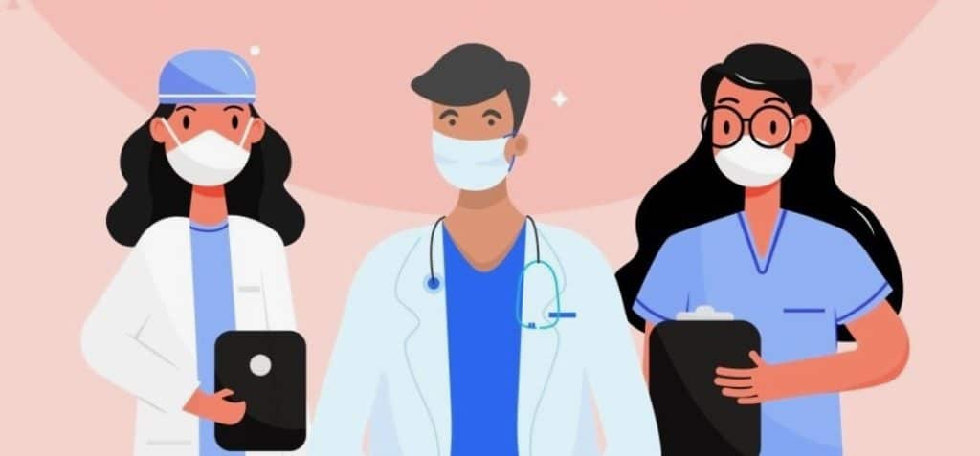
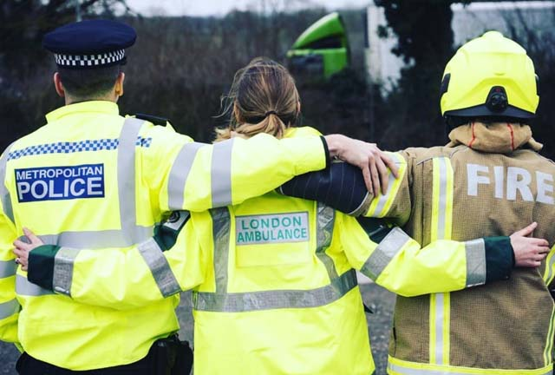


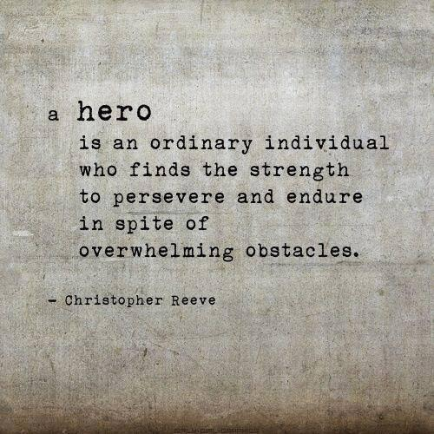
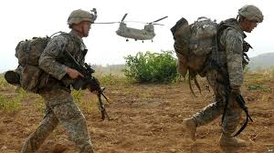

These are my thoughts – I am sure you have more…
Can I also remind you all of something…

Slide 4

Notes:
You are a hero by being brave throughout these challenging and difficult times; a hero by being kind; a hero because you have helped at home; a hero for standing up for what you believe is right (as long as it’s done in the right way); a hero because you made someone laugh when they were sad; a hero for being you! I could go on. You all make a difference no matter how big…or small. Heroes don’t always wear capes.
If you want to, please join me in saying a little prayer.
Dear Lord,
Help our Drive family through this time of turbulence.
Give us strength to be who we are and make a difference, no matter how small.
Give us all the strength to be heroes.
Amen

