Slide 1
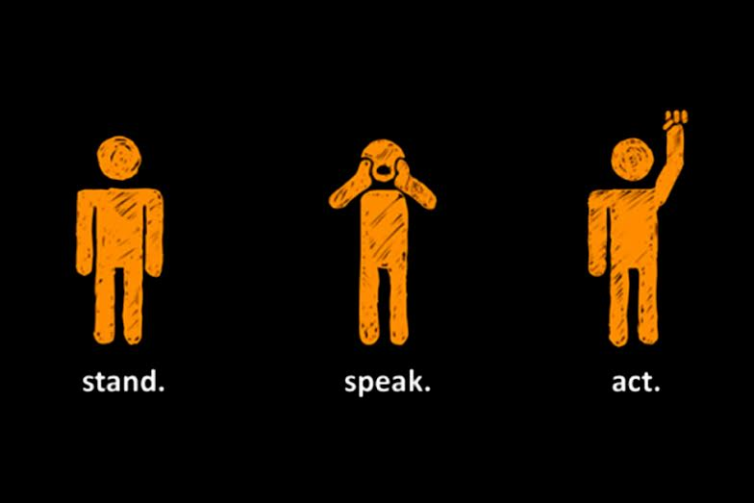
What is cyberbullying?
Are you a bystander or an upstander online?

Slide 2







How are you all using the internet/apps at the moment?
Twitter requires people using the service to be 13 years of age or older.
Facebook requires everyone to be at least 13 years old.
Instagram requires everyone to be at least 13 years old, but you may have an account.
Common Sense Media has recommended that this app is appropriate for those aged at least 16 years old and above.

Slide 3
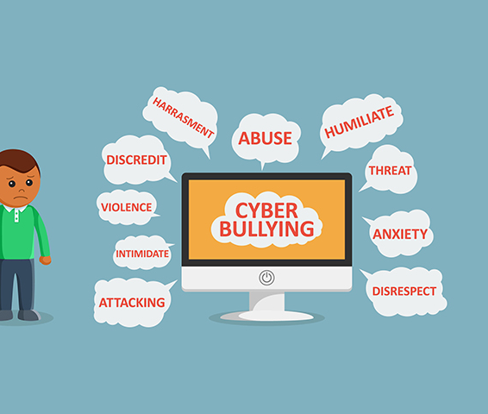
These are all platforms for keeping in touch during this lockdown period, but can also be platforms for cyberbullying.
What is cyberbullying?

Slide 4
So, if you thought cyberbullying was happening to a friend or yourself, what would you do?
Ava sees that Isaac has had a lot of tweets all making ‘jokes’ about the way he answered a question at school. Ava sends Isaac a message to say that she thinks he’s great and to ask if he’s ok.
Upstander
James is hanging out with his friends after school and they start sending nasty WhatsApp messages to one of his friends. James doesn’t feel comfortable about it but he doesn’t say anything.
Bystander
What should he have done?
ALWAYS TELL A TRUSTED ADULT: THEY CAN HELP!

Slide 5
Appropriate for KS2 https://www.youtube.com/watch?v=RGcLa-vyxVQ&feature=youtu.be
ALWAYS TELL A TRUSTED ADULT: THEY CAN HELP!

