Slide 1
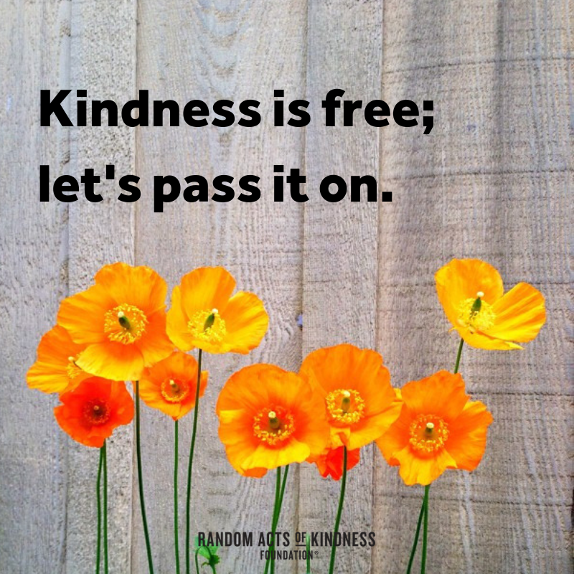

Kindness
Every Little Helps!

Slide 2
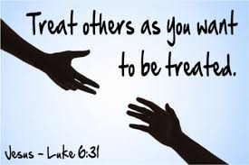
Sometimes, it is easy to forget to be kind. Being kind means thinking about someone else and being willing to put their needs first.
It can also mean being kind to yourself too. If you know how to be kind to yourself, then you will understand how to be kind to others.
Treat others as you want to be treated.
Think about the ways in which people are kind to you.
How did you feel when someone was kind?
How can you show kindness to someone today?

Slide 3
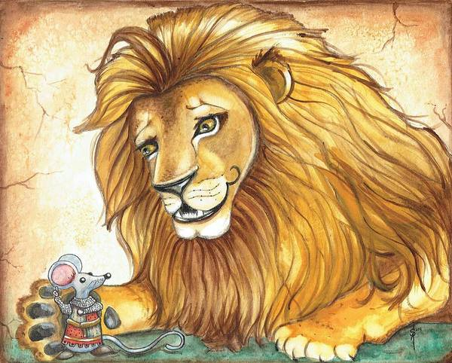
Every Little Helps!
The Lion and the Mouse
https://youtu.be/tkH6qBSWkPU

Slide 4
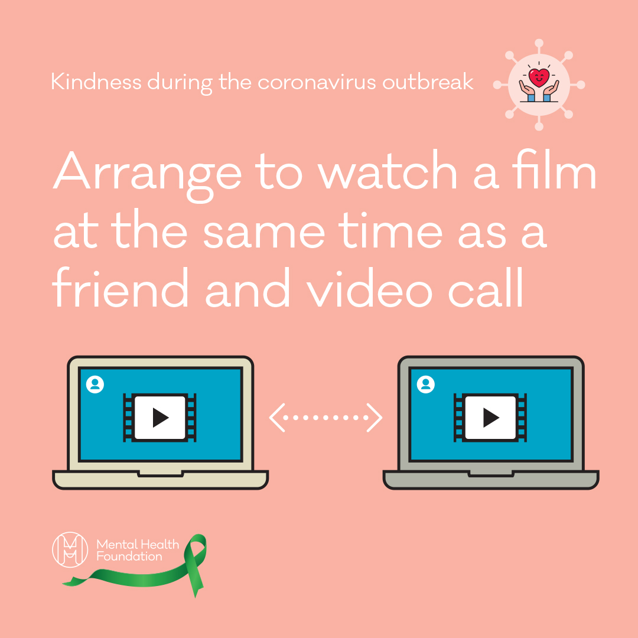
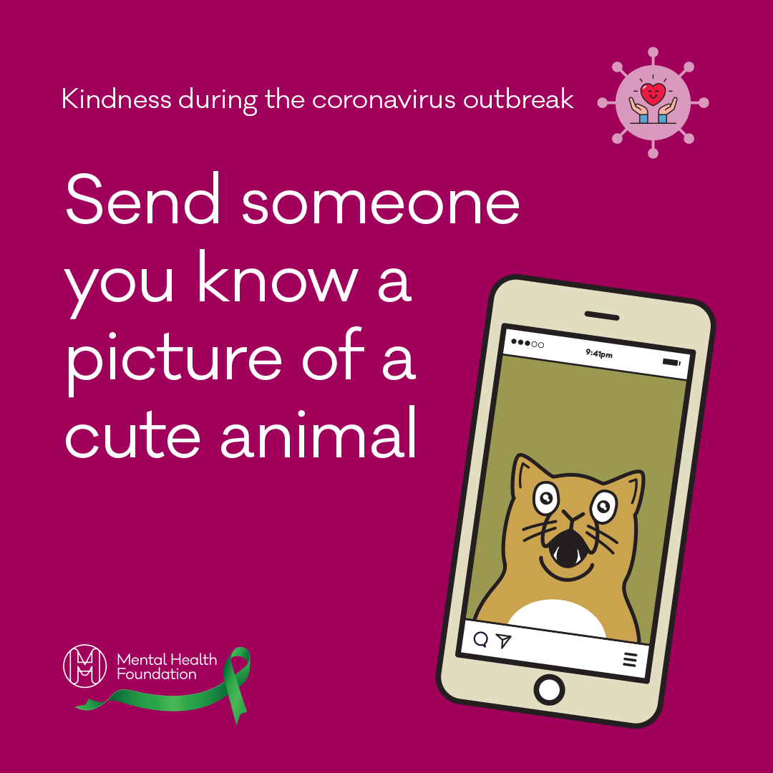
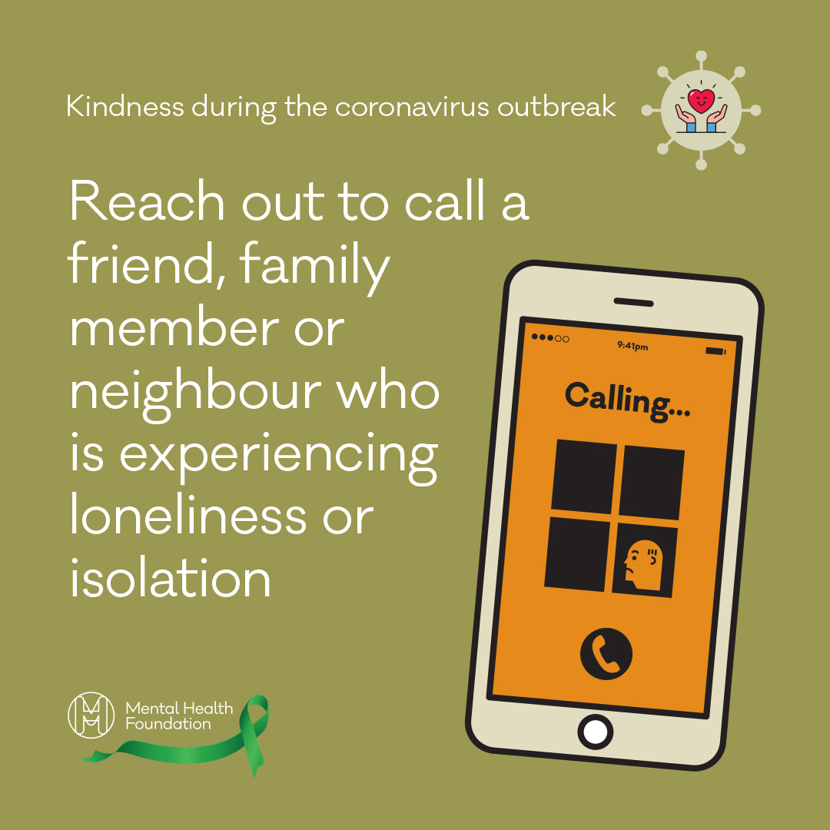
Why not challenge yourself to a week of kindness or longer if you like (kindness is free)!
Parents/Carers can join in too.
https://www.mentalhealth.org.uk/coronavirus/acts-kindness-during-coronavirus-outbreak

Slide 5
Get involved with acts of kindness
Call a friend that you haven’t spoken to for a while
Tell a family member how much you love and appreciate them
Make a cup of tea for someone you live with
Arrange to have a cup of tea and virtual catch up with someone you know
Help with a household chore at home
Arrange to watch a film at the same time as a friend and video call
Tell someone you know that you are proud of them
Tell someone you know why you are thankful for them
Send a motivational text to a friend who is struggling
Send someone you know a joke to cheer them up
Send someone you know a picture of a cute animal
Send an inspirational quote to a friend
Send an interesting article to a friend
Contact someone you haven’t seen in a while and arrange a phone catch up
Spend time playing with your pet
Reach out to call a friend, family member or neighbour who is experiencing loneliness or self-isolation
Donate to a charity
Lend your ear – call a colleague and ask how they’re finding the change in routine
Give praise to your colleague for something they’ve done well
Arrange to have a video lunch with a colleague
Send an inspirational story of kindness people around the world are doing for others to someone you know
Donate to foodbanks
Offer to skill share with a friend via video call - you could teach guitar, dance etc.
Offer support to vulnerable neighbours
Offer to send someone a takeaway or a meal

