Slide 1

Protective Parenting
Managing Behaviour Effectively and Safely
www.clennelleducationsolutions.org
Reviewed July 2021
Notes:
Begin by setting the scene and context for todays meeting
Will look at local developments and projects and an overview of current practice guidelines.
Will talk about the LSCB

Slide 2
Aims
To consider the role of parent / carer in managing behaviour
To explore appropriate expectations around behaviour
To explore a range of techniques for managing behaviour effectively
To consider how to discipline children safely through effective chastisement
To consider the role of Parenting Programmes as a support for managing behaviour at home

Slide 3
Ground Rules
Respect each others’ opinions
Listen to contributions
Confidentiality
Feel free to ask questions
Please turn mobile phones to silent

Slide 4

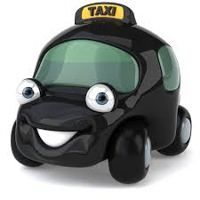
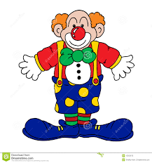


Parenting Role Activity
In your groups write a list of the different jobs that you do as a parent/carer.
Notes:
Re-inforce to parents that their role is often one which is taken for granted yet involves a multitude of skills and juggling and a reminder of its importance and value for their child.

Slide 5


Would you apply for this job?
Notes:
Read out the job description.

Slide 6
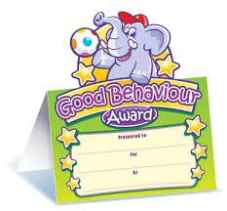

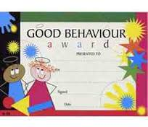
Why would your child get this award?
Notes:
Ask parents to think about what specific behaviours their child displays that they are happy about – thinking of their own children.
Explain to parents that it is important for children to know what the clear expectations are around their behaviour and break it down so that we avoid using “be good”.
It is also important to highlight and explain (calmly) to children why their behaviour has been unacceptable.

Slide 7
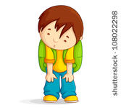
What can affect
the way I behave?
Notes:
Ask parents to answer this question.

Slide 8
Special Educational Needs
Consistency, routines and boundaries
Tiredness (them and us)
The weather!!
Family circumstances e.g. loss / separation
Age
What can affect behaviour?
Friendships
Boredom
Low expectations
Lack of respect
Habit
Poor communication skills
Changes of mood
Notes:
Expand and give examples on each point.
Emphasise that even children with SEN or other additional needs still require routine, boundaries and consistency.

Slide 9
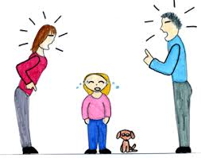
What can affect how we manage our child’s behaviour?
Notes:
Ask parents to give ideas.

Slide 10
Routines &
boundaries
Parenting
Styles
How we were
parented
Tiredness
What affects how we manage our children’s behaviour?
Stress
Personal
difficulties
Friends
Mental
health
Time
Lack of
support
Other people
Notes:
Own parenting – how we are influenced by the way in which we were parented ourselves.
Parenting styles – how it is important to have consistent parenting styles amongst all carers. Children respond in different ways to different styles e.g. assertive versus aggressive etc.
Other people / friends – can be supportive. However, many parents report that embarrassment or fear of being judged (or actually being judged) by others affects how they respond in certain situations e.g. child having a tantrum in a supermarket.
Emphasise that even children with SEN or other additional needs still require routine, boundaries and consistency.

Slide 11
Giving Commands and Expecting Compliance
Children require routine and boundaries. Children who have consistent boundaries display fewer behavioural problems than those who do not.
Children test boundaries at every level.
It is normal for children to defy instructions for 35% of the time.
To expect children to immediately comply with every command causes unnecessary stress for you when they don’t comply.
Notes:
The next 3 slides deliver information to parents that they need for the activity on slide 14.

Slide 12
Giving Commands
Do not expect 100% immediate compliance
Be clear, concise and precise
Use appropriate language for age / development stage
Do not use questions in your commands – reduce the level of choice
Do not give too many commands
Acknowledge your child’s feelings when dealing with behaviour and expecting them to follow your commands.
Notes:
Give examples of some commands that parents can use e.g. instead of saying, “Will you put your coat on?” say “Put your coat on”.
Instead of saying, “Do you want toast or cereal?” say “You can have toast or cereal”

Slide 13

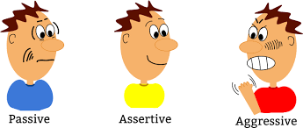
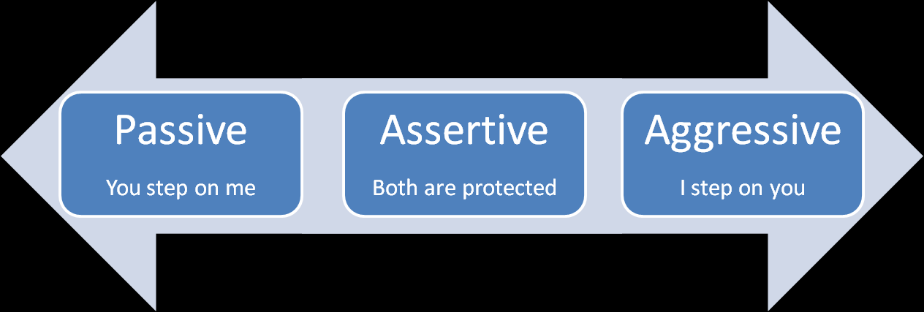
Sound like
you’re in charge!
Feel like you’re
in charge!
Notes:
Remind parents to be assertive / confident in their style and not passive or aggressive. Children are more likely to respect and respond to an assertive/confident parent who shows them respect too.
Passive – the child will over rule the parent and won’t respect them.
Aggressive – someone could be hurt (emotionally, physically) and again does not encourage the child to respect the parent.
Assertive – both parties win – parents clearly communicate and child is more likely to respond.

Slide 14
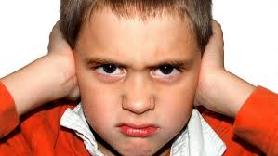
Activity:
Are these commands effective?
Notes:
Refer to “Commands Worksheet” – Ask parents to work together to discuss each command on the sheet and decide whether they think it is effective. If they believe it is not effective then ask them to think about how they can rephrase it.

Slide 15

Can you pick
up your coat?
No!
I can’t!!
Pick up your coat and hang it up please.

Slide 16

Break each step down – one at a time. If a child displays quite challenging behaviour then reward / praise after each successfully completed step.
It is time for bed now. Put
away your toys, go upstairs,
clean your teeth, put your dirty
washing in the basket, wash
your face then get out your
book for your bedtime story.
I’m so confused…what
did you ask me to do?
I can’t remember!

Slide 17

How many times have
I got to tell you,
don’t leave that there!!!
7?
The command opens up an opportunity for the child to respond with a number. Use more respectful language. I’ve told you lots of times that your toy doesn’t stay there. Put it back in the box when you have finished playing with it please.

Slide 18
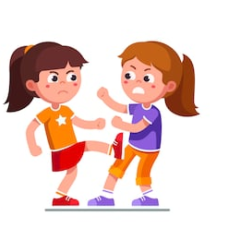
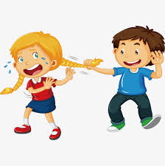
Don’t hit
your sister!
Ok, I will kick her
or pull her hair
instead then.
Suggestions:
Be kind to your sister. Use kind words. Play nicely.
Keep your hands and your feet to yourself.

Slide 19
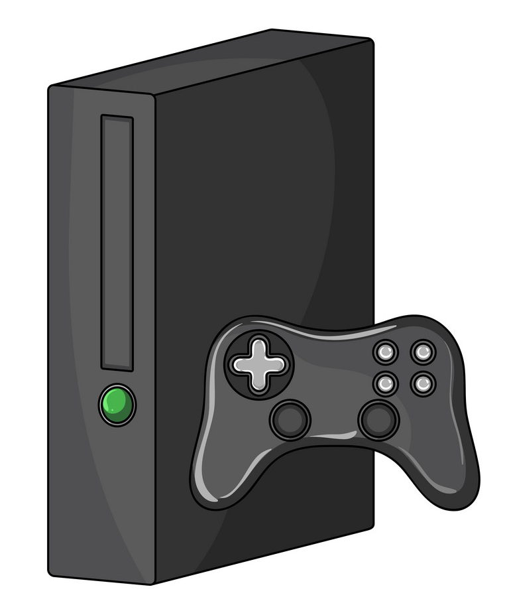
In 5 minutes it will be time to end your
X-Box game because it will be time for bed
in 5 minutes.
You have 2 minutes remaining.
Ok, it is now time to finish. Turn off the
X-Box. It is bed time now.
This is effective because it gives the child plenty of warning
and a clear expectation. You must ensure you follow up
on your timescales e.g. remember to go back in
5 minutes or 2 minutes etc.

Slide 20
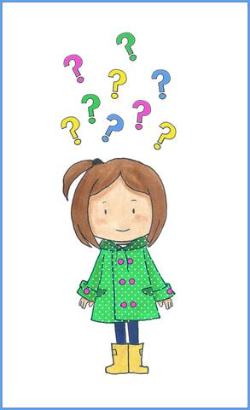
Be good!
Too vague. When the child is
calm, sit with them to talk
through what your expectations
of being good are.
What behaviours do you expect
to see from your child?

Slide 21

Ways in which you can deal with behaviour safely and effectively
Remain calm
Be consistent and clear
Reinforce positive behaviour
Ignore negative behaviour
Notes:
Give examples / clarify each point. Points 3 and 4 are discussed in more detail in future slides.

Slide 22
How can you reinforce positive behaviour?
Notes:
Ask parents to write a list of the different ways that they can encourage more acceptable behaviour to be displayed again.

Slide 23
Non-cost /
low-cost
rewards
Role-modelling
Labelled
praise
Reinforcing
Positive Behaviour
Reward
Charts
Praise even
small things
Notes:
Discuss how parents can praise good behaviour e.g. hug, high five, emphasise low cost or non cost such as extra time on games console, trip to the park etc.
Labelled praise – being specific about what it is that children have done that is good. Put a label on the good behaviour.
Encourage parents to create opportunities to praise their child e.g. things that they know they can do well.

Slide 24

Benefits of Reward Charts
Valuable way for children to track their own progress.
Do not cost anything / low cost.
Can be re-used at a later date.

Slide 25
Principles of a Reward Chart
The way it is explained.
Agree with your child (before you start) when/for what reason the sticker will be awarded.
Agree achievable goals – not too many.
Agree what “special thing” will happen when the goal has been reached.
Allow child to decorate their own chart with parents/carers.
Do NOT remove stickers.
Do NOT expect an improvement in too many different behaviours all at once.
Notes:
Expand / clarify each point and ensure parents understand the main principles.
Have at least one or two things that you know the child will achieve and one they need to work on.

Slide 26
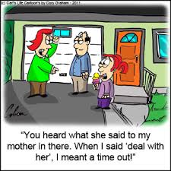
What can you do so that you are not re-inforcing negative behaviour?
Notes:
Discuss what the issue is in the picture – does it address the behaviour or has the father simply rewarded the child’s negative behaviour with a treat.

Slide 27
In your groups, write a list of things that you can do to avoid encouraging a repeat of the negative behaviour.
Notes:
Some possible answers on the next slide.

Slide 28
Role-modelling:
Show your child how you
can deal with conflict in
a positive way. Don’t
enter into arguments.
Time Out
Ignore
Not
reinforcing
negative
behaviour
Distract
Keep an open mind
support school
when informed about
negative behaviour.
Do not talk about
your child’s negative
behaviour in front
of your child.
Be consistent

Slide 29
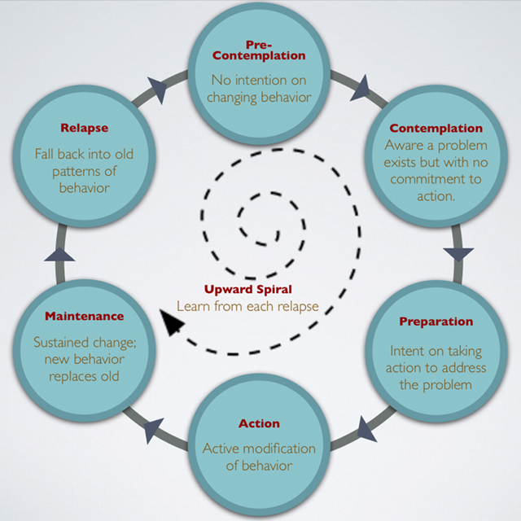
Change doesn’t happen overnight!
Prochaska & DiClemente (1983)
Notes:
To see a change in behaviour, parents need to persevere and not give up at the first relapse. Remind parents that there will be relapses and there will be good days and bad days but that it is important to keep going and keep trying. Eventually the number of relapses will reduce and the child will learn how behaviour is going to be addressed and will begin to regulate/modify their own behaviour as a result.

Slide 30

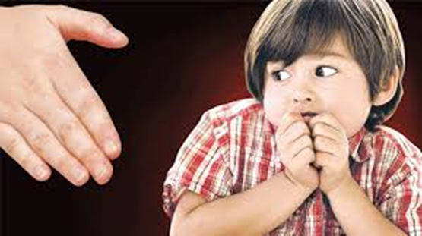
Is it ok to smack my child?
The law states that it is illegal for parents to use anything harsher than reasonable chastisement (mild forms of physical punishment) to discipline their child.
It is a chargeable offence (ABH) if a smack causes bruising, grazes, scratches, minor swellings, cuts or other marks (e.g. red skin)
It is a criminal offence to use an object
Notes:
Schools don’t smack but have strategies to manage behaviour that have an impact.
Optional handout on smacking.
Emphasise how a large adult hand can have significant consequences when used against a child even without the parent perhaps meaning to. When someone resorts to hitting another person it usually stems from anger, stress, frustration so can have harmful consequences for the child and repercussions for the parent.

Slide 31

What can you do instead of smacking?
Notes:
Ask parents to give ideas. Some example answers on the next slide. Trainer can choose whether to give out the leaflet on smacking.

Slide 32

Praise and reward good behaviour at every opportunity to encourage more of it
Show love and warmth
Let your child know that it is their behaviour (not them) that you dislike
Lead by example – “Learn What They Live” Poem
REMAIN CALM!!
Ignore unacceptable behaviour
Distraction
Notes:
Option to read out the “Learn What They Live” poem.

Slide 33
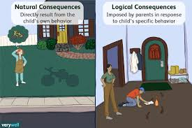
What if a punishment or consequence is necessary?
Use Time Out
Remove privileges
Curfew
Increase chores
Notes:
Unpick each one.
Emphasise realistic consequences.

Slide 34
Conclusion
Be consistent in your approach.
Encourage other adults in your family to adopt the same approach.
Don’t give up when things go wrong.
Talk to others and don’t be afraid to ask for help.

Slide 35

Parenting Programmes
Incredible Years
Strengthening Families
Parent Factor
Notes:
Explain what parenting programmes are available in your area and know how to signpost or refer parents appropriately.
Amend slide where appropriate.

Slide 36

Any Questions?

