Slide 2
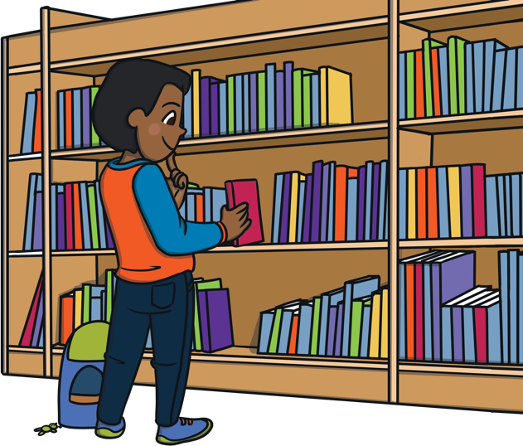
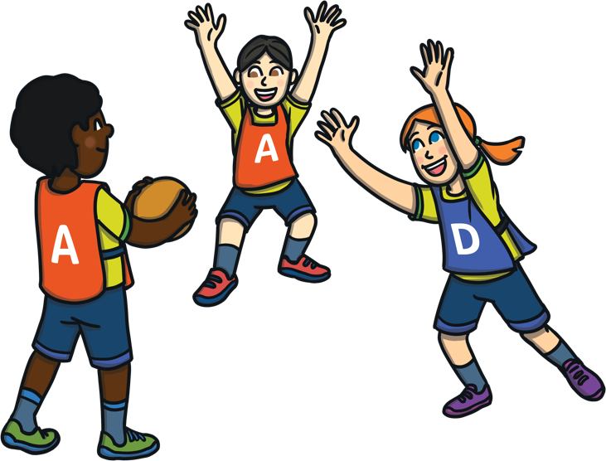
At school I do lots of fun learning
activities in the classroom.
Sometimes I do activities with my class in other rooms, like the Art Room or Library, or go outside for P.E.

Slide 3

When I am at school, I might need to practise safety drills. Drill means practise. We might practise going outside in a fire or finding a safe place during a lockdown.
In a lockdown drill, we pretend that there is danger outside and we need to go or stay inside to make sure we are safe.

Slide 4


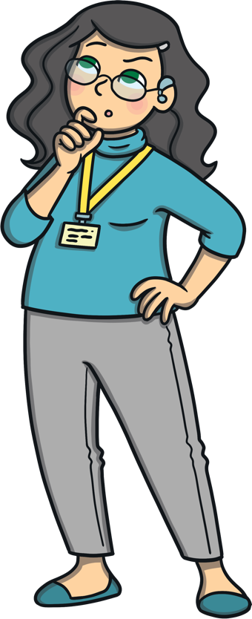
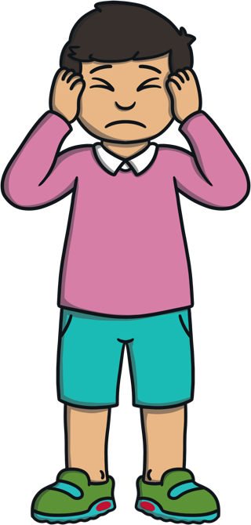
When the lockdown drill happens, I will
hear a loud noise like a siren or bell.

Slide 5
Then my teacher will tell me and my class what we need to do next. In a lockdown, this means we stop what we are doing and sit together on the floor. My teacher might tell me to sit under a table or in a safe space where no one can see us. I might need to wait for a while. My teacher will tell me when it is safe to move.

Slide 6
If I am outside when I hear the lockdown siren, the teacher I am with will tell me what to do. This will usually mean we walk calmly to the closest building and go inside.
I might have to sit in a different room to make sure that I am safe. The teacher and my friends will be with me.

Slide 7
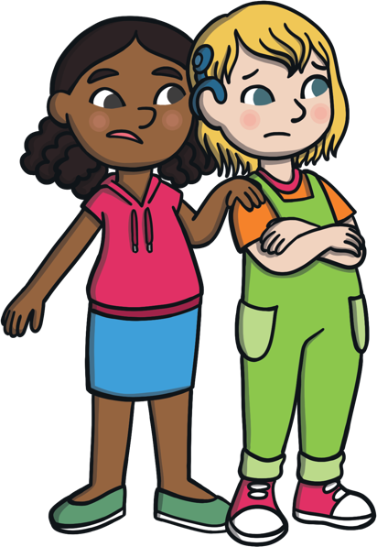
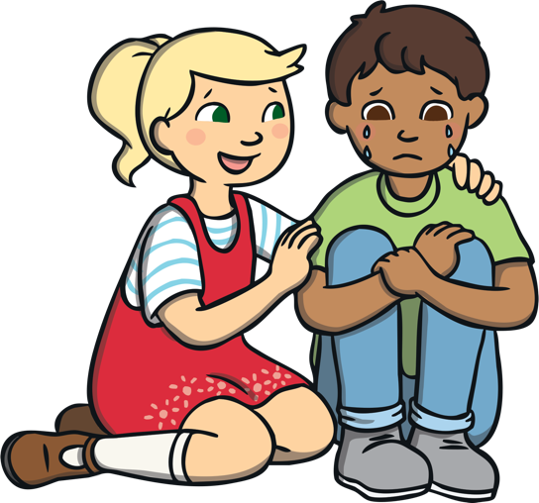
Some students might feel a bit anxious or worried about doing the lockdown drill. It is ok to have these feelings.
We practise doing lockdown drills so that if a real situation happens, we know what to do. Practising a lockdown drill might help me feel better about the situation.

Slide 8
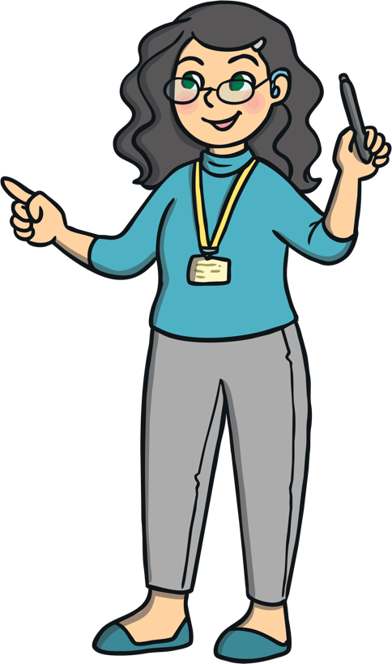
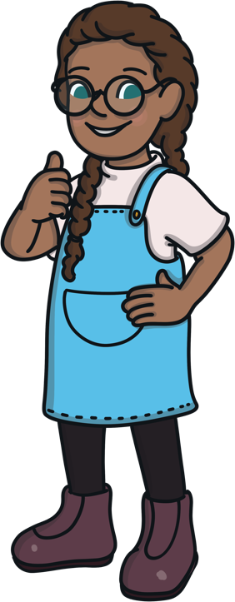
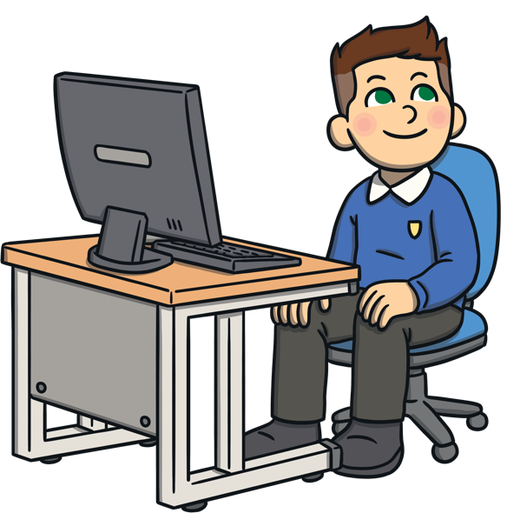
When there is a lockdown drill, it is a good idea to listen to my teacher. My teacher will tell me where
to go and how to be safe. I will try and listen to my teacher and stay inside so I am safe.

